Slide 1

PROJECT 2: ETL
Stranger Things

Slide 2


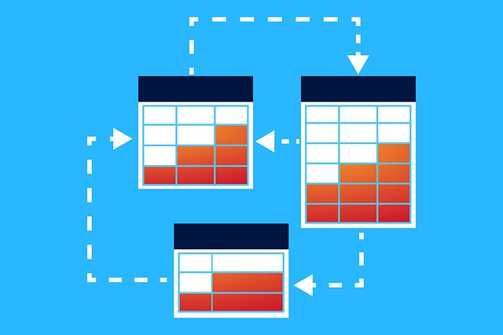

Our goal
Our goal is to extract data from 4 datasets, select the required column based on the database requirements, perform data transformations, data loading and optimization of the database.
Data Transformation
Data Loading
Data Extraction

Slide 3
Design process
Collecting database requirements and analysis & data acquisition 04/01/2021
Database design
Data extraction: column selection from each dataset
Applying transformations
Load
Optimization / normalization
ER Modeling

Slide 4
Database objectives
Actors table:
Actors and actresses’ names & numerical field (age)
Boolean (living/dead)
Film table:
character field for original title
average critic rating
film field
datetime field for runtime
Producers table:
Characters table:
producer’s name
links to film table
character name
links the actors and film tables

Slide 5
Extraction
Parsing fields from csv for loading in the database

Slide 6
Translation & mapping
Translation: conversion of data from formats used in one system to formats which can be used in another system.
Choice of columns and mapping to the relevant data types:
for easy understanding and improve
Important for display

Slide 7
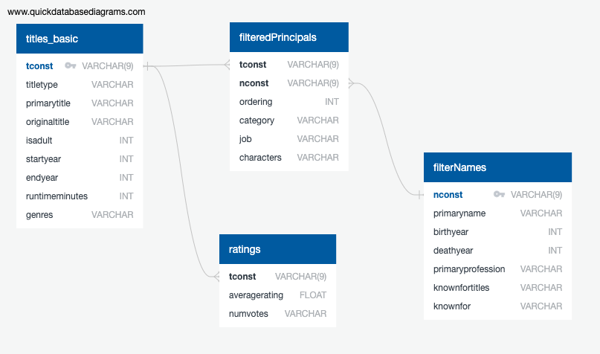
ERD

Slide 8
Data Transformation
Querying and Creating Specified Views from tables.

Slide 9
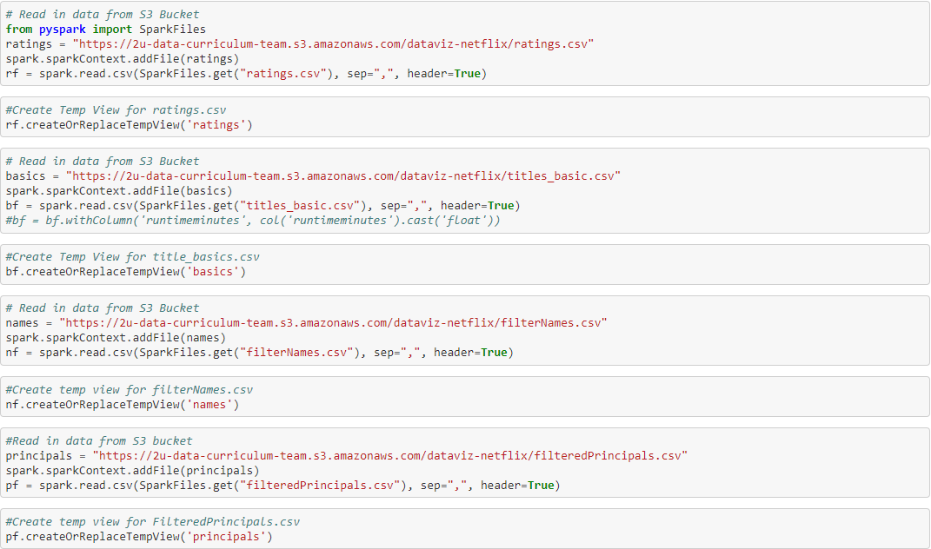
Reading Our data from s3 buckets

Slide 10
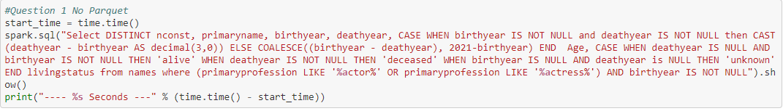
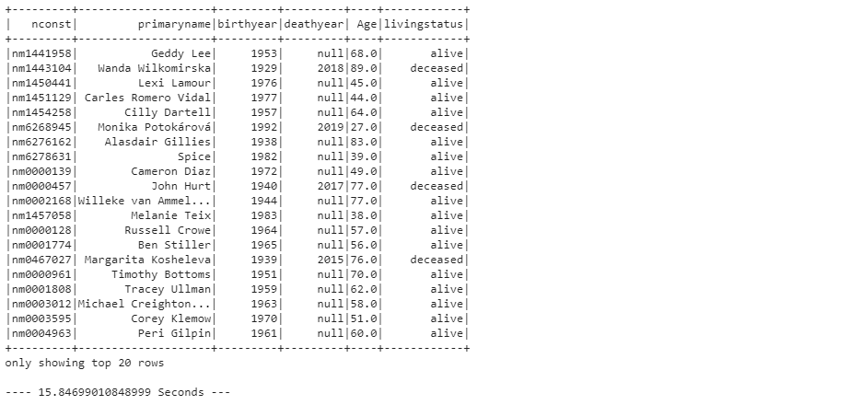
DATA TRANSFORMATION:Actors table
Actors table

Slide 11
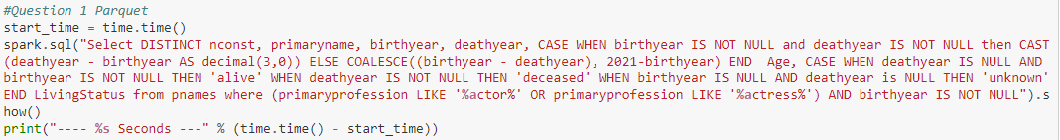
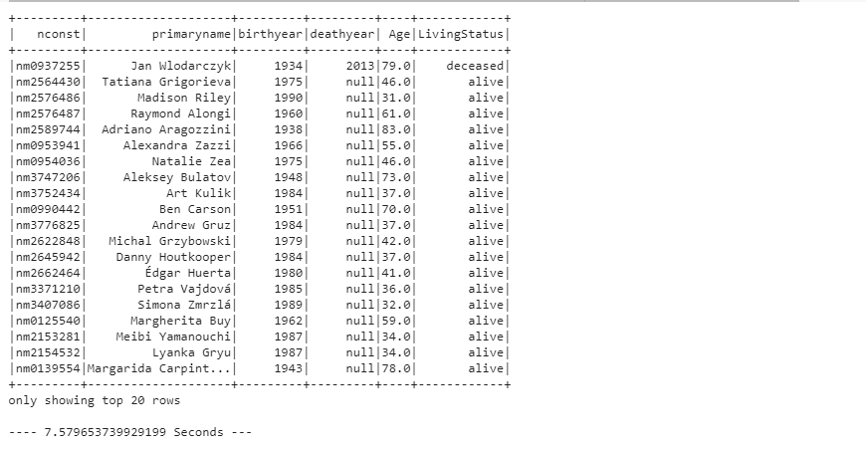
Actors table: Parquet

Slide 12
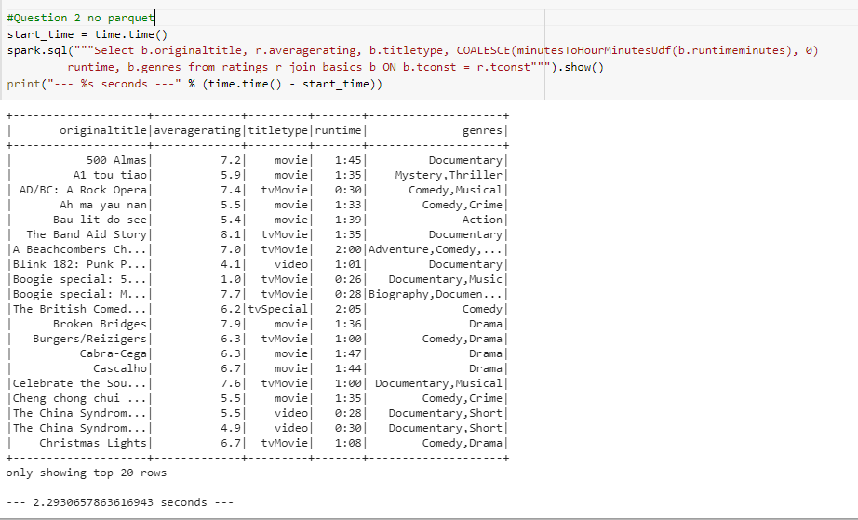
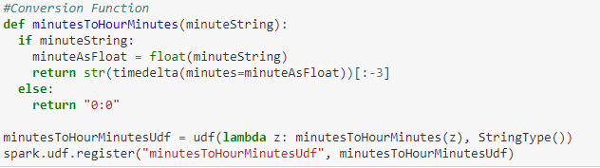
Data transformation: Film table

Slide 13
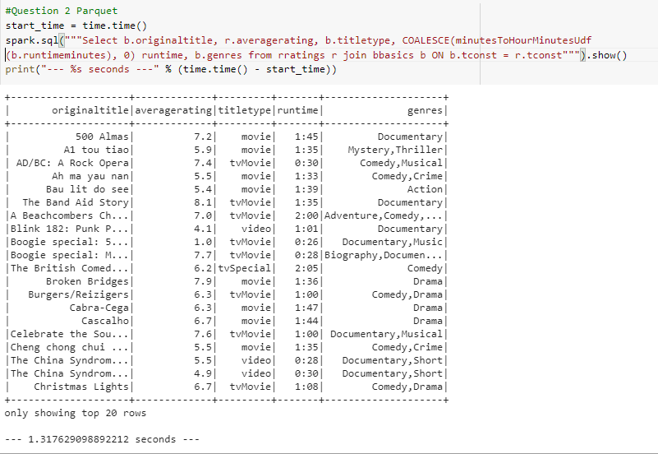
Film table :Parquet

Slide 14
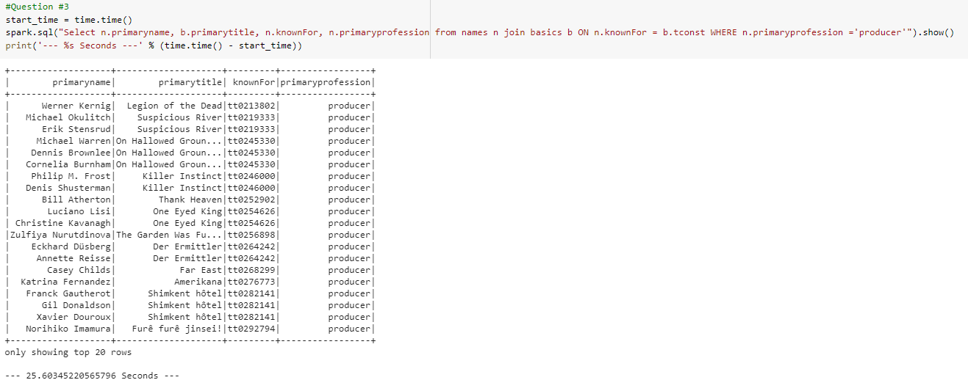
Data transformation: Producer table

Slide 15
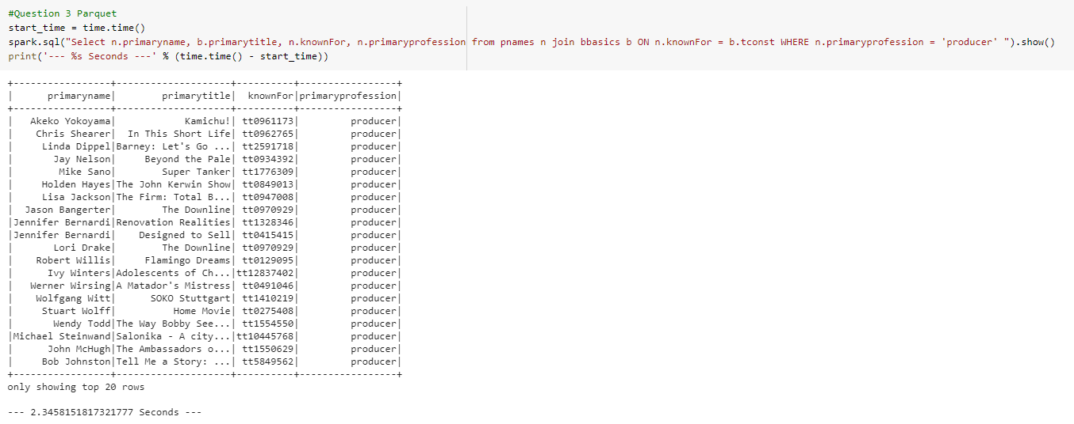
Producer table: parquet

Slide 16
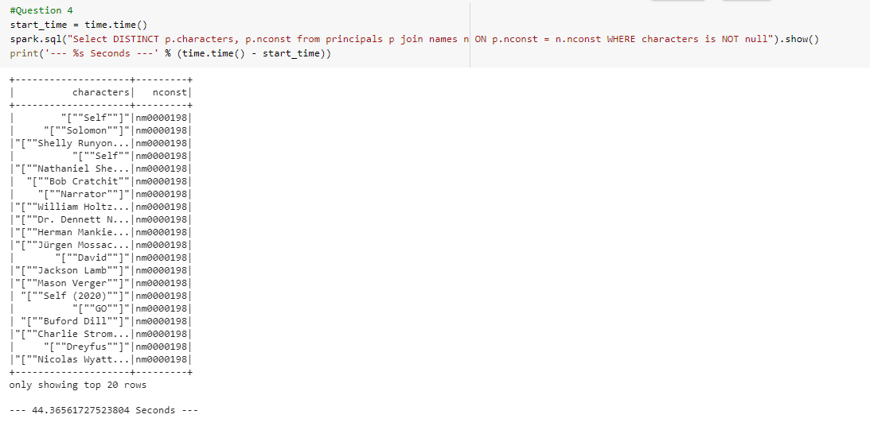
DATA TRANSFORMATION: Characters table

Slide 17
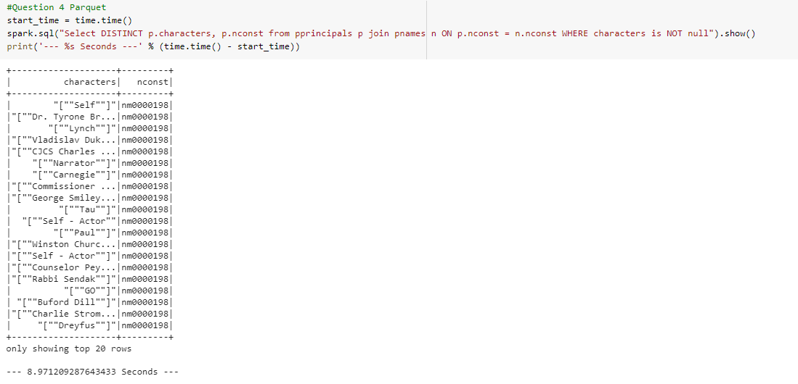
Character table: PARQUET

Slide 18
Conclusion
We completed the creation of the 4 tables as stated in the database design requirements.
Demonstrated the performance improvement of the database by implementing parquet.
Created the Entity Relationship Diagram for the database.

Slide 19

Questions?

